Slide 1
Management Activities in SE
Estimate of Effort and Costs.

Slide 2
Types of Costs
Facilities: hardware, space, furniture, telephone, etc.
Software tools for designing software
Staff (effort): the biggest component of cost

Slide 3
Pre-requisite to Estimating Effort
Understand the scope of the project to be built
Generate an estimate of size

Slide 4
An Example
Software Module | Estimated LOC
User interface and control facilities (UICF) Two-dimensional geometric analysis (2DGA) Three-dimensional geometric analysis (3DGA) Database management (DBM) Computer graphics display facilities (CGDF) Peripheral control function (PCF) Design analysis modules (DAM) | 2,300 5,300 6,800 3,350 4,950 2,100 8,400
Estimated lines of code | 33,200
Effort?
Productivity?

Slide 5
Estimating Size
The accuracy of a s/w project estimate is predicated on a number of things:
The degree to which the planner has properly estimated the size of the product to be built
The ability to translate the size estimate into human effort, calendar time, and dollars (required availability of past records)
The degree to which the project plan reflects the abilities of the s/w team
The stability of product requirements and the environment that supports the s/w engineering effort

Slide 6
Estimating Size
Sizing represents the project planner’s first major challenge
Size refers to a quantifiable outcome of the s/w project (e.g. LOC and/or FP)

Slide 7
Estimating Size
Three different sizing options are available
Application points
Function points
Lines of source code

Slide 8
Estimating Size and Effort
Example of baseline productivity metrics are LOC/pm or FP/pm

Slide 9
An Example
Software Module | Estimated LOC
User interface and control facilities (UICF) Two-dimensional geometric analysis (2DGA) Three-dimensional geometric analysis (3DGA) Database management (DBM) Computer graphics display facilities (CGDF) Peripheral control function (PCF) Design analysis modules (DAM) | 2,300 5,300 6,800 3,350 4,950 2,100 8,400
Estimated lines of code | 33,200
Effort?
Productivity?

Slide 10
An Example of LOC-Based Estimation
Estimated lines of code = W = 33,200
Let,
Average productivity = X = 50 LOC/pd
Labor rate = Y = $100 per day
So,
Cost per line of code = Z = Y/X = $2
Total estimated project cost = W*Z = $66,400
Estimated effort = W/X = 664 person-days

Slide 11
An Example of LOC-Based Estimation
Estimated lines of code = W = 33,200
Let,
Average productivity = X = 600 LOC/pm
Labor rate = Y = $5000 per month
So,
Cost per line of code = Z = Y/X = ?
Total estimated project cost = W*Z = ?
Estimated effort = W/X = ?

Slide 12
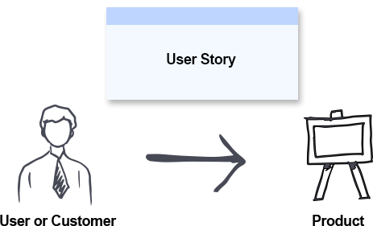
Estimation in Agile
Project Velocity
The amount of work an agile team can complete in a sprint
Story Points
The amount of effort required to implement a user story
User Story
A requirement or general explanation of software feature

Slide 13

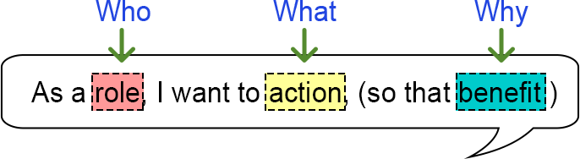
Examples of User Stories
As a [customer], I want [shopping cart feature] so that [I can easily purchase items online].
As an [manager], I want to [generate a report] so that [I can understand which departments need more resources].
As a [customer], I want to [receive an SMS when the item is arrived] so that [I can go pick it up right away]

Slide 14
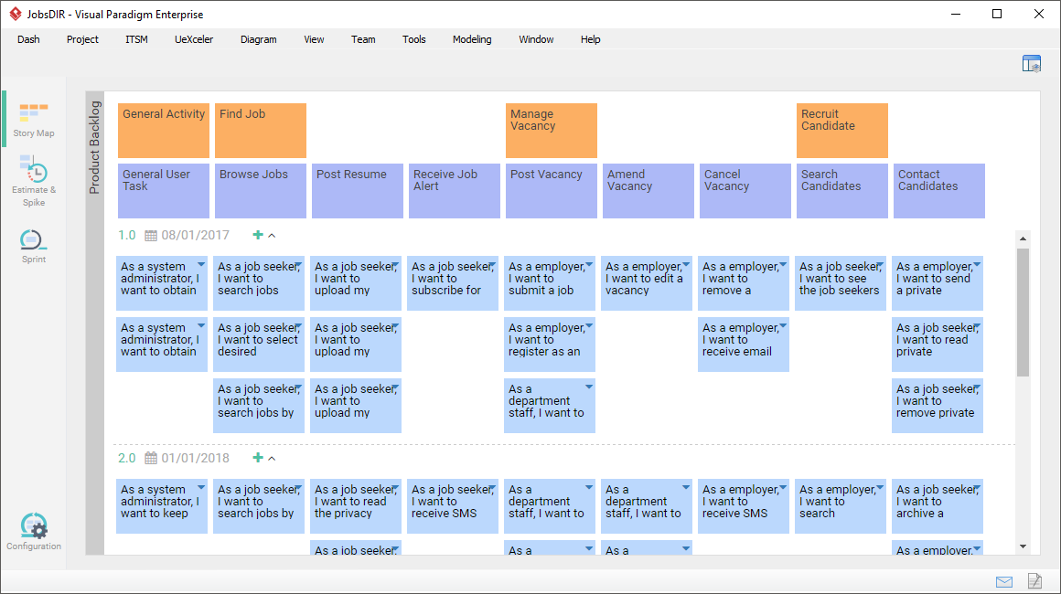
Example

Slide 15
Estimation in Agile
Project Velocity
Story points completed ÷ Number of sprints

